Slide 1
Real-time Stress Detection on Social Network Posts using Big Data Technology
JYOTI SINGH (122AD0020)
VASANTHA (122AD0030)

Slide 2
Research Paper Overview
Title: Real-time Stress Detection on Social Network Posts using Big Data Technology
Dataset: - Dreaddit (190,000 Reddit posts, 3,553 labeled instances)
Class Distribution: 1,870 stressed vs. 1,683 non-stressed posts
Technologies Used in Paper: - Apache Kafka (Streaming)
- Apache Spark (Processing)
- Apache Airflow (Pipeline Orchestration)
Models Implemented in Paper:
Traditional ML: Logistic Regression, SVM, Random Forest, Decision Trees, Gradient-Boosted Trees
Deep Learning: BERT, RoBERTa, DistilBERT, XLNet, Electra
Best Accuracy : Logistic Regression – 69.39%

Slide 3
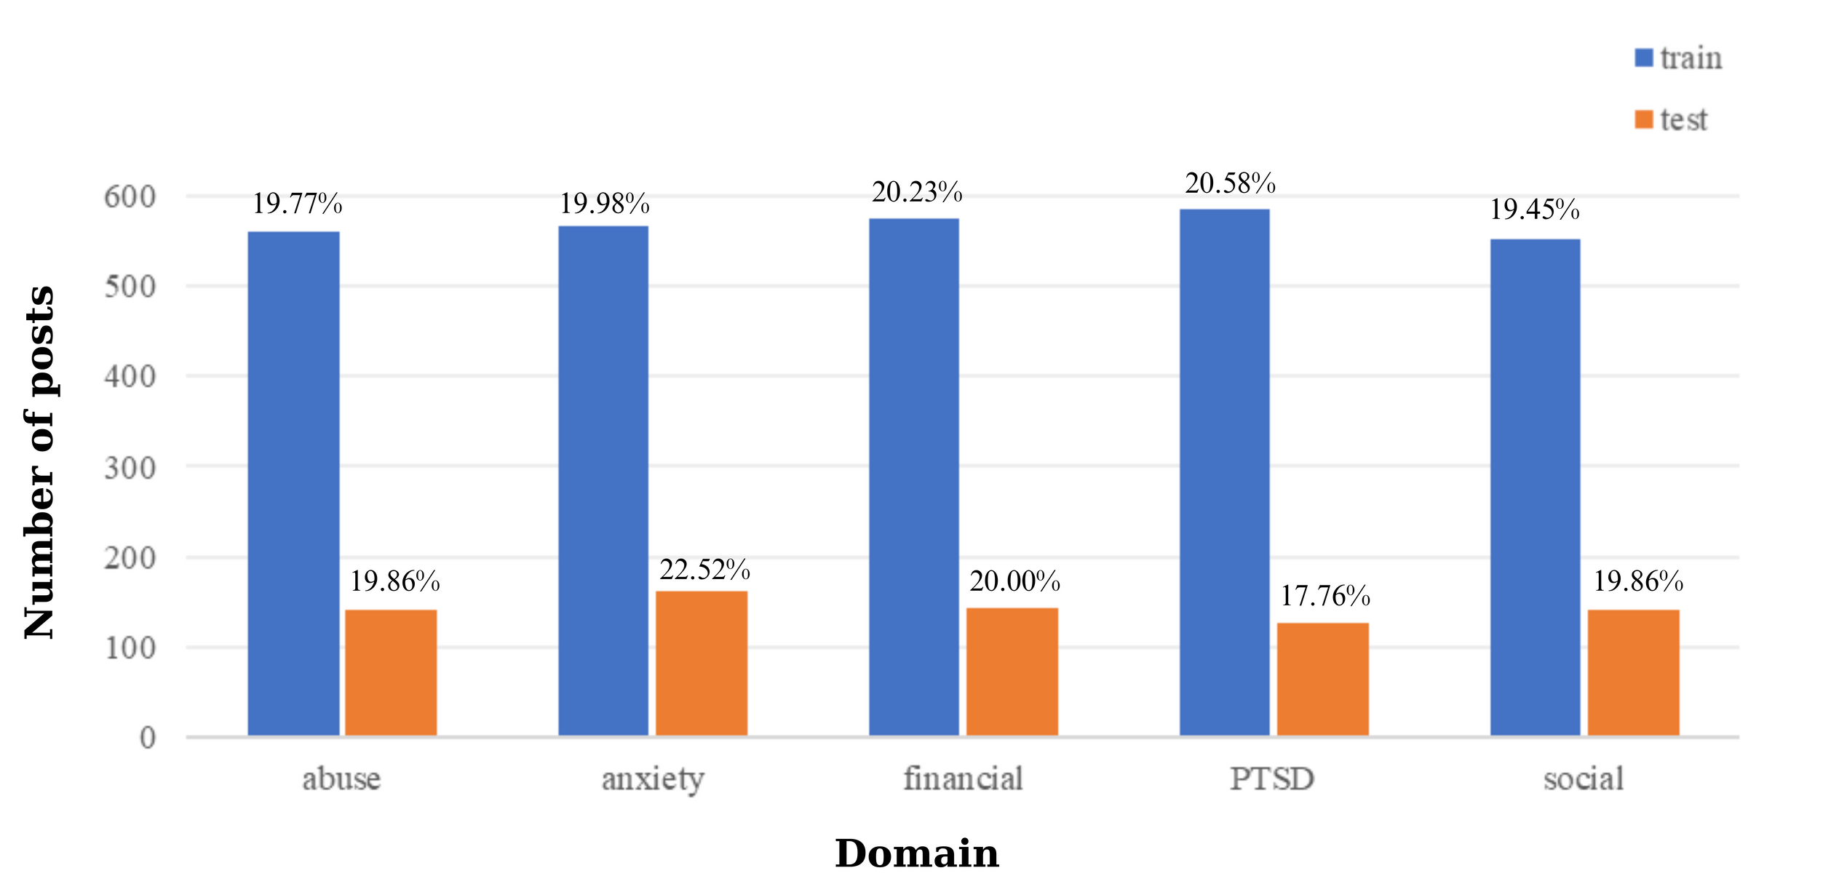
Figure 2: The chart of representation of the number and proportion of posts in 5 domains on the training and test set

Slide 4
Sample Posts And Labels
Post –
"It's like that, if you want or not. ME: I have no problem, if it takes longer. But you asked my friend for help and let him wait for one hour, and then you haven’t prepared anything. That’s not what you asked for. Instead of 3 hours, he helped you for 10 hours till 5 AM..."
Label: 0
Post –
"We'd be saving so much money with this new house... It's such an expensive city... I did some googling in their language and found that it was illegal for them to do that. I was excited like oh ok if it happens. The contract is long term so we'd have to give 6 months notice before leaving even if we give it next week... I wanna die I swear I haven't been so helpless and scared in so long..."
Label: 1

Slide 5
Our Implementation Overview
Objective: Real-time stress detection in social media posts using big data & deep learning
Major Differences from Paper:
- Used Streamlit instead of API for an interactive front-end
- Used Hadoop & Spark for large-scale data processing
- Applied ensemble methods for improved accuracy

Slide 6
System Architecture Workflow
1. Data Collection: Reddit posts from Dreaddit dataset.
2. Data Ingestion: HDFS stores input social media text
3. Data Processing: Spark performs TF-IDF transformation
4. Model Training: ML models trained on labeled data
5. Inference: Predictions made on new data

Slide 7
Data Preprocessing Steps
Tokenization: Splitting text into words (Done using Tokenizer)
TF-IDF Transformation: Converting text to numerical features
HashingTF: Converts words into numerical vectors
IDF: Computes TF-IDF scores
Input Text: "I love this amazing book"
After Tokenization: ["I", "love", "this", "amazing", "book"]
After TF-IDF Transformation: Each word is converted into a numerical feature vector
[0.2, 0.0, 0.8, 0.5, ..., 0.3]
(HashingTF + IDF are applied to get this vector)

Slide 8
Machine Learning Models Implemented
Decision Tree- Simple, interpretable model with hierarchical splits
Gradient-Boosted Trees- Combines multiple weak classifiers for better performance
Support Vector Machine (SVM)- Finds optimal hyperplane for classification
Logistic Regression- Statistical model for binary classification
Ensemble Learning Approaches
Hard Voting- Aggregates predictions from multiple models (majority rule)
Stacking - Uses predictions from multiple models as input for another model

Slide 9
Deep Learning Models Implemented
XLNet- Transformer-based model with bidirectional learning
BERT- Pre-trained deep contextual model for NLP
DistilBERT- Lighter, faster version of BERT
RoBERTa- Optimized BERT with dynamic masking
Electra- Efficient training with generator-discriminator model

Slide 10
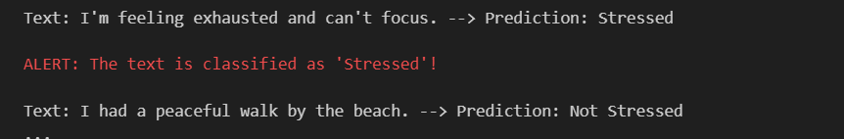
Sample Prediction
Text: shows the input given to be classified
Alert generated when stressed post

Slide 11
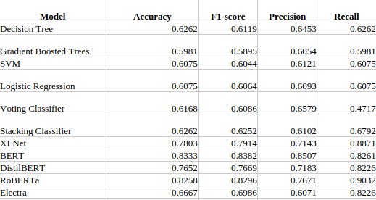
Results

Slide 12
Implemented Enhancements
Model Improvements
Ensemble Learning
Implemented Voting Classifier (Hard Voting) using Decision Trees, GBT, and Logistic Regression.
Developed Stacking Classifier with Random Forest and GBT as base models and Logistic Regression as the meta-classifier.
Fine-tuning Deep Learning Models
BERT-based Stress Classification Model
Applied Domain-Specific Pretraining with class-weighted loss for imbalanced datasets.
Optimized learning rate and epochs for better generalization.

Slide 13
Thank You

